Slide 1
KLIC keep learning & innovation in our community
WORKSHOP.
Todays Topic
WW43 2022
KLIC Team.

Slide 2

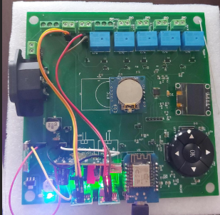
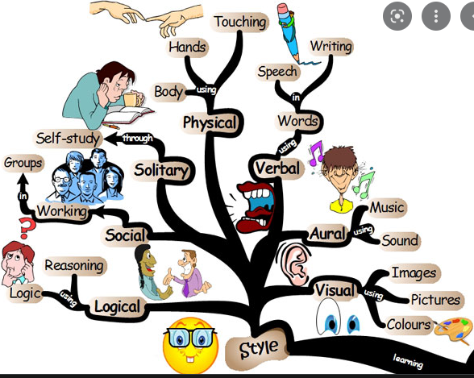
Klic Workshop Content
From an Idea to a Physical Project Solution:
Not under industrial standards but very professional.
Processes and Learnings
Product

Slide 3
Klic Spirit
Friendship
Free Software Use
Commitment and Support
Share Learnings
Phycological safety

Slide 4
KLIC Workshop Content:
Topic | Expectation | Comments | Owner | Prework | Time
Define Project Idea | Define clear Idea with specific details. | Write You Idea, Inputs, Outputs, Requirements, components, cost, Learnings, time bound. | J. Preciado |  | 15 | 3:15
Architecture Project | Overview from different Areas of Architecture | Architecture overview for: Board, system, Software | J. Preciado |  | 5 | 3:20
Component Selection | Main Components selection and implications | Understand the implications to select each of the major components, Technologies, etc. | J. Preciado |  | 5 | 3:25
Power Analysis | Understand Power planes and current consumption. | Get a list of components to understand the power delivery in the system. | Gilberto |  | 7 | 3:32
Schematics | Install EASYEDA and create a Small project Connections. | Have a clear practice on EasyEda Tool to connect and design a circuit. Split circuitry in pages for clarity. | M. Casillas |  | 20 | 3:52
Break | Break | Break | Break | Break | Break | Break
CAD Layout | Do a quick Connection in CAD, understand the | Understand how to create a board since scratch, define stack up. | J. Jauregui |  | 20 | 4:12
Sign OFF for TO Process | Understand Sign Off Process. | Understand the importance and implications of Reviews. Pedigree/Change list | Jorge Hdez |  | 7 | 4:19

Slide 5
KLIC Workshop Content:
Topic | Expectation | Comments | Owner | Prework | Time
Material procurement | Understand Material program Management. | Understand the process, and different tools to pay. | Felipe Lopez |  | 10 | 4:30
GitHub | The use of GitHub to handle a software project. | Understand GitHub Use how we are using it in our project. | Marco Mora | Install Git | 20 | 4:50
Visual Studio Code / PlatformIO. | Explain how we are using Visual Studio to code our Micro Controller Code. | Understand different application to use depending in our needs and preferences. | Polanco J. Daniel | Install Visual Studio Code | 20 | 5:10
Online Compilers Cpp.sh | Understand different compilers options in the Web. | The intention is that we create one quick program and display results. | J. Preciado | Nothing. | 3
Mechanical Design Tool FreeCAD | Understand different options | Share our current progress. |  | ??? | 5

Slide 6
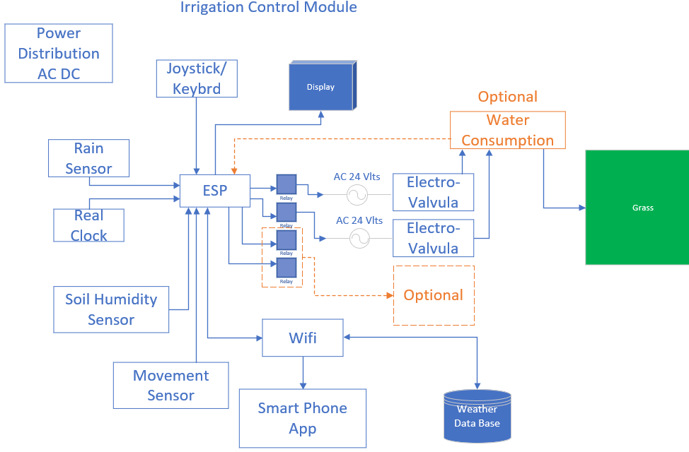
Klic Content: Project Idea
Topic | Expectation | Comments
Define Project Idea | Define clear Idea with specific details. | Write You Idea, Inputs, Outputs, Requirements, components, cost, Learnings, time bound.
Get clear definition about your Idea:
Write it in a paper is important:
Define Inputs, Outputs, General Purposes
Main components understand technology and cost
Get a physical prototype as soon as you can
Consider ProtoBoard tool

Slide 7
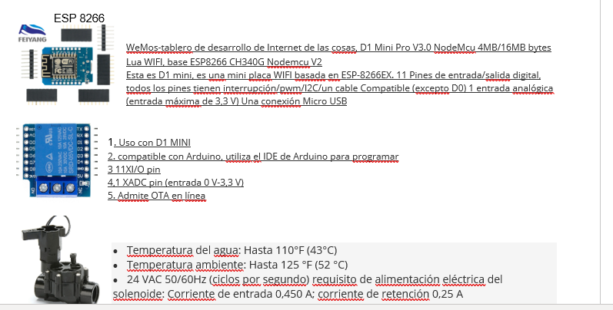
Klic Content:
Topic | Expectation | Comments
Architecture Project | Overview from different Areas of Architecture PAS (Product Architecture Specs) | Architecture overview for: Board, system, Software
Garden Irrigation Module: Overview
The Irrigation module requires to 2 modules one for front garden and 2 for backyard garden. One section will be feed with 3/4” pipes and the second one will feed with ½” pipes hydro installation will not be included in this document, pipes, electro valve, sprinklers that are not part of this PAS.
Define project then you will notice it needs to change, because tech, cost, schedule, etc.
Define components and write his specs part number etc. it will help to share your Idea and project participants will refer to same document.
How you will use it, how you will build it, Architecture for: Mechanical, software, system, etc.

Slide 8
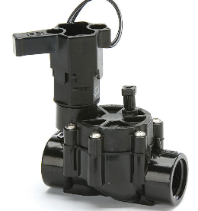
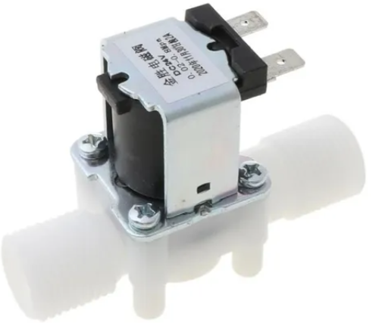
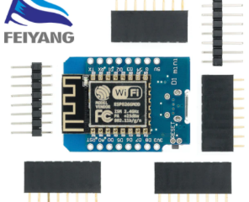
Klic Content:
Topic | Expectation | Comments
Component Selection | Main Components selection and implications | Understand the implications to select each of the major components, Technologies, cost, etc.
For Component selection, these are some of the Questions to ask:
Use Mode, Component reliability, Endure, Compatibility (Volts, AC, DC, Current), Cost.
Electronics characteristics: Wifi, Bluetooth, any other, are you considering any project scalation, how, why?
Component Selection is part of PAS.

Slide 9
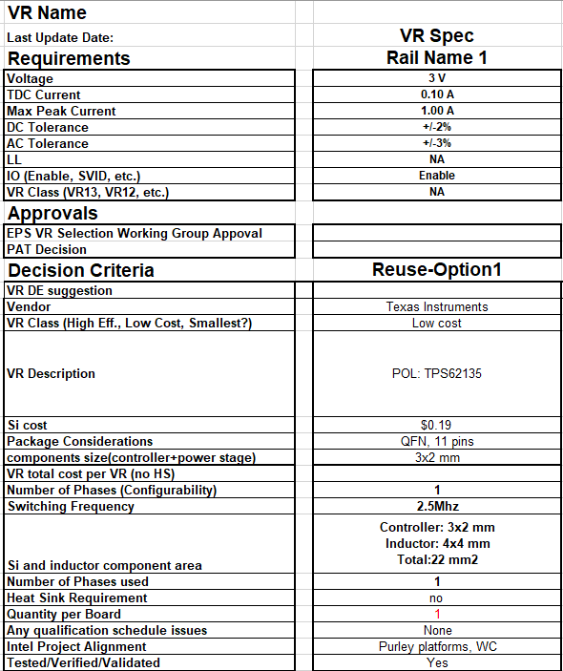
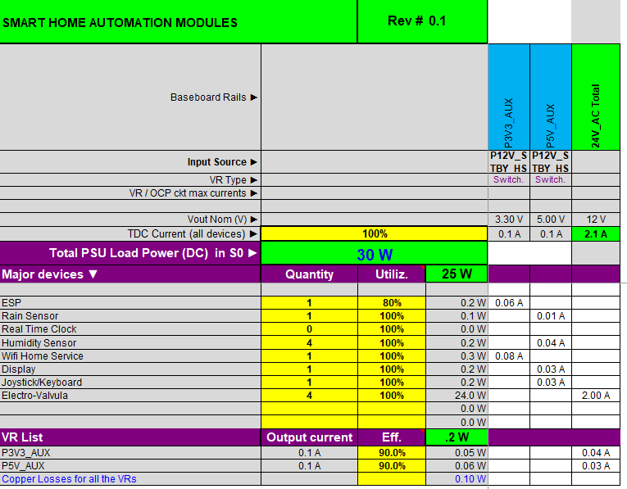
Klic Content:
Topic | Expectation | Comments
Power Analysis | Understand Power planes and current consumption. | Get a list of components to understand the power delivery in the system.

Slide 10

Klic Content:
Topic | Expectation | Comments
Schematics | Install EASYEDA and create a Small project Connections. | Have a clear practice on EasyEda Tool to connect and design a circuit. Split circuitry in pages for clarity.
https://easyeda.com/
Schematic Capture
Circuit simulator
Online PCB design
Schematics and PCB file import
Collaborative environment
Open-source Hardware
Schematics and PCB sharing

Slide 11
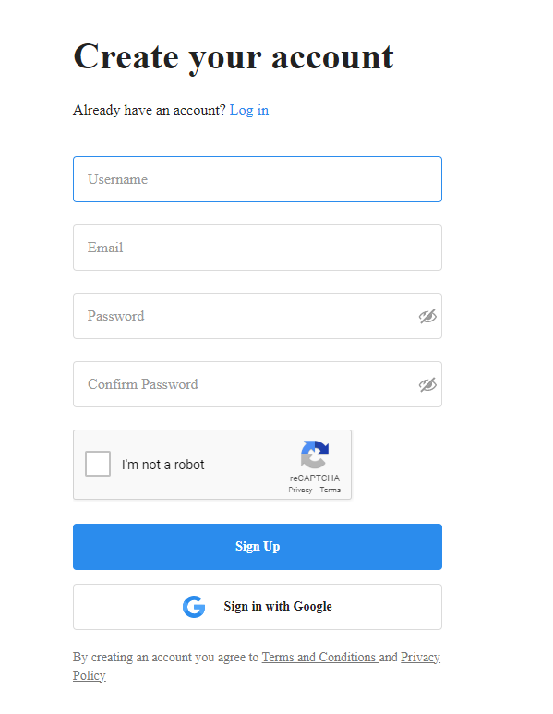
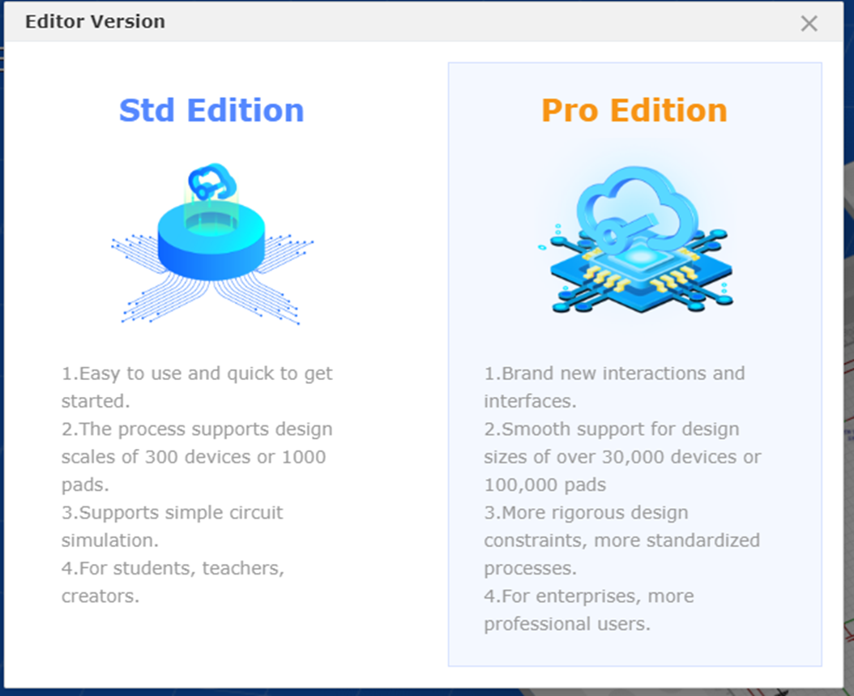
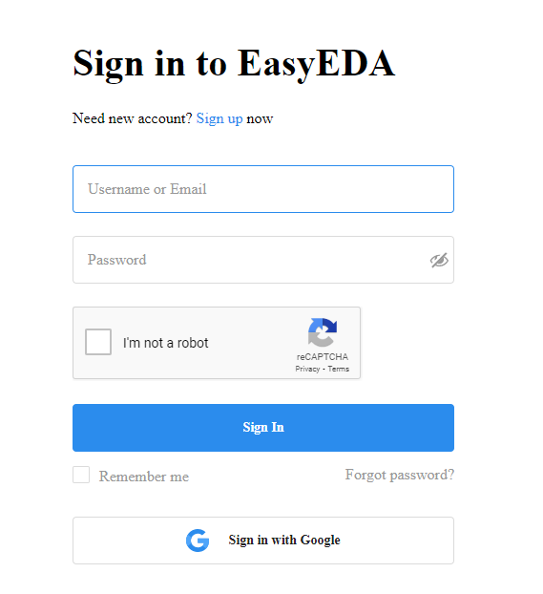
Klic Content:
Topic | Expectation | Comments
Schematics | Install EASYEDA and create a Small project Connections. | Have a clear practice on EasyEda Tool to connect and design a circuit. Split circuitry in pages for clarity.

Slide 12
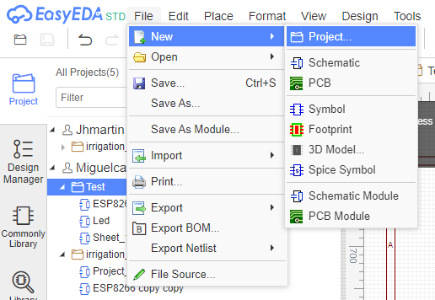
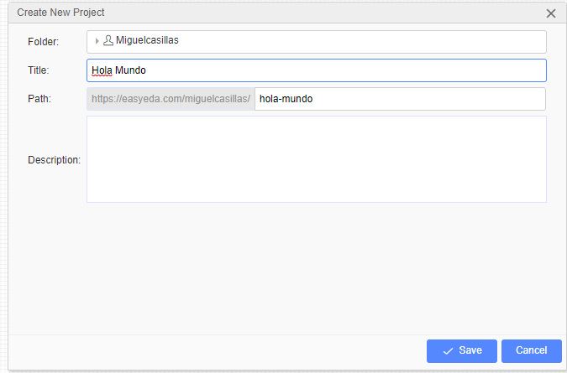
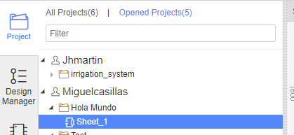
Klic Content:

Slide 13
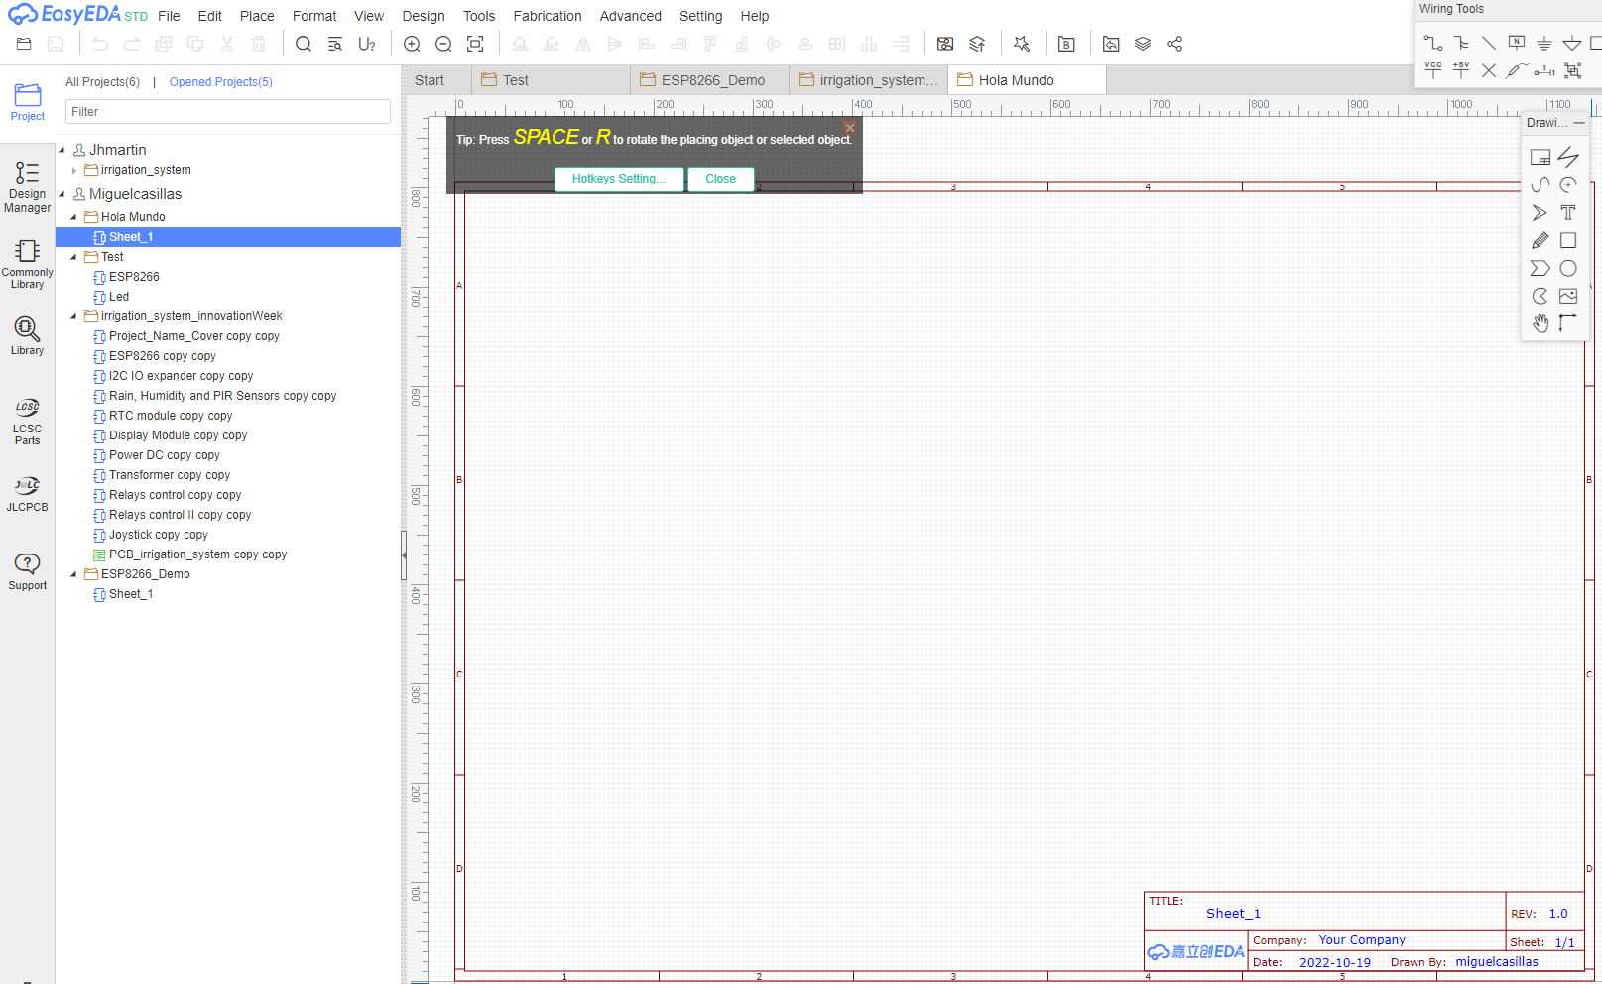
Klic Content:

Slide 14
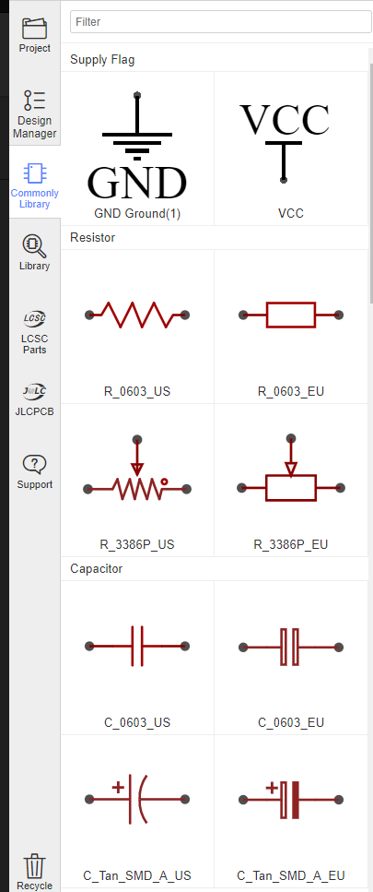
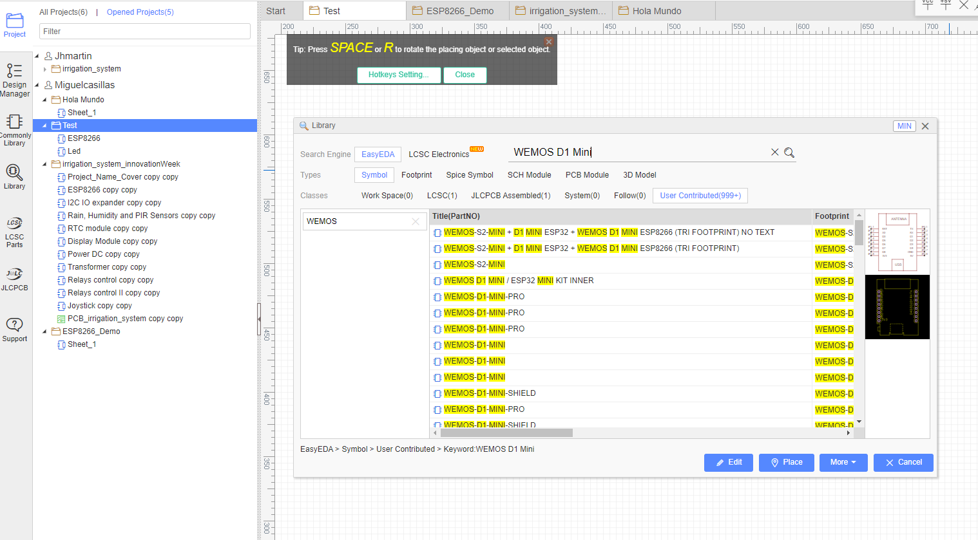
Klic Content:

Slide 15
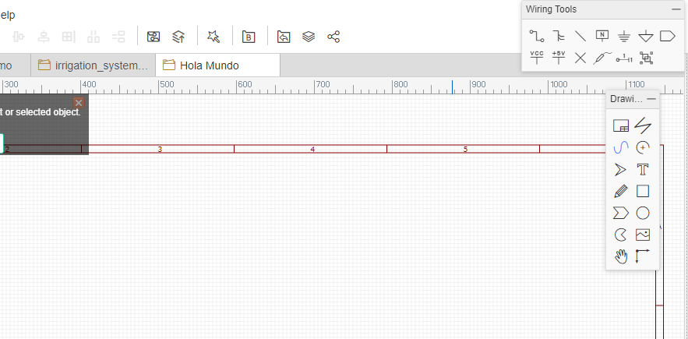
Klic Content:

Slide 16
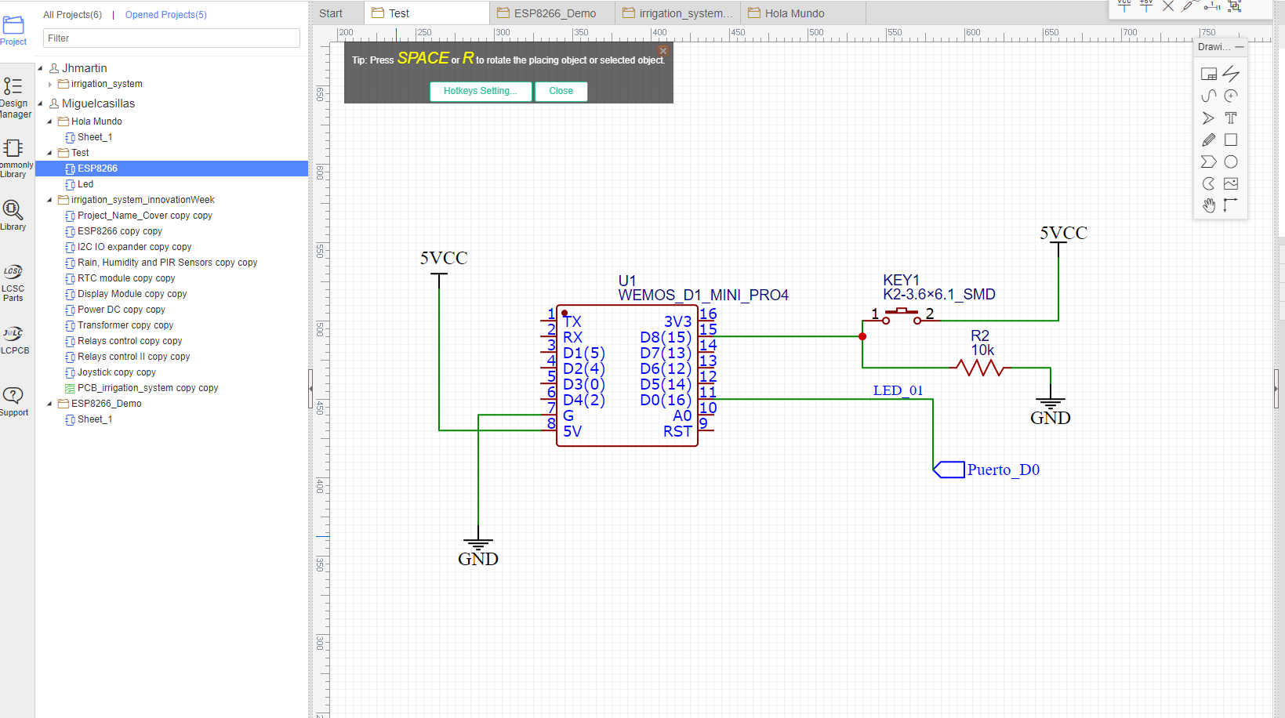
Klic Content:

Slide 17
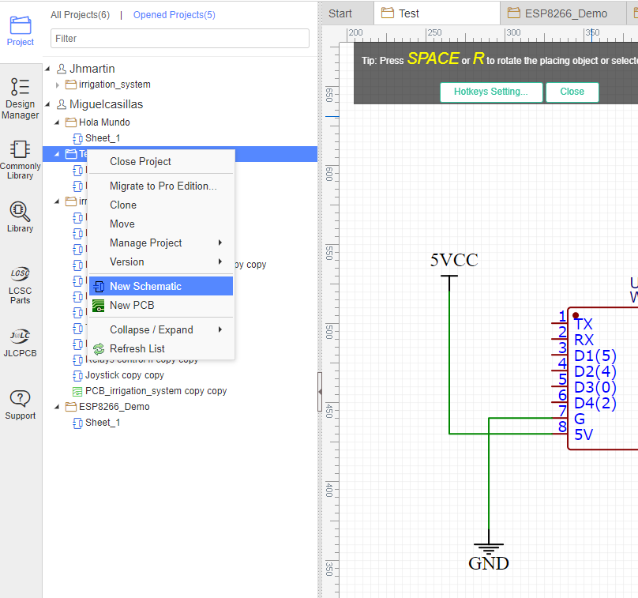
Klic Content:

Slide 18
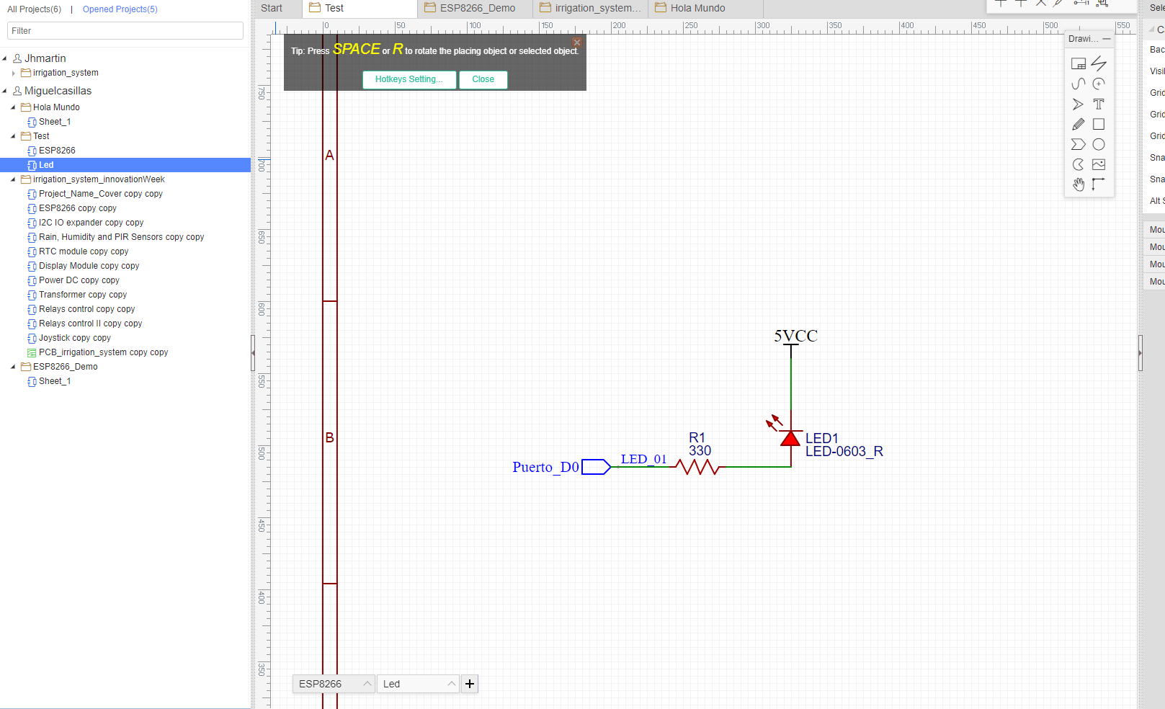
Klic Content:

Slide 19

Klic Content:
Topic | Expectation | Comments
CAD Lay out | Do a quick Connection in CAD, understand the | Understand how to create a board since scratch, define stack up.
Mechanical(Size shape, drill, Mounting holes)
Testing(vias, pins, etc)
Manufacture(min geometries and spacing)
Gerber or ODB++
Electrical(Stack up geometries, power)
Libraries(components footprints)
Schematic

Slide 20
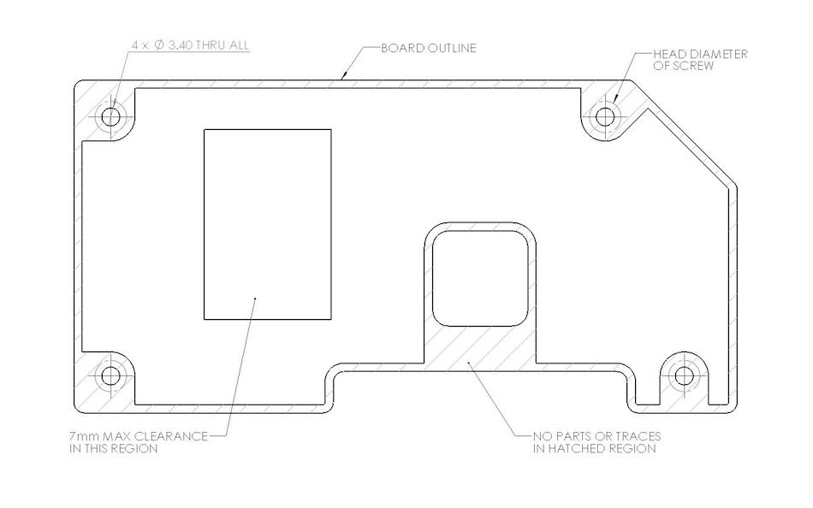
Klic Content:
For new design, after the placement define the outline
Mechanical(Size shape, drill, Mounting holes)
Testing(vias, pins, etc)
Manufacture(min geometries and spacing)
Gerber or ODB++
Electrical(Stack up geometries, power)
Libraries(components footprints)
Schematic

Slide 21
Klic Content:
Add or definetest points, could be connector or vias.
Mechanical(Size shape, drill, Mounting holes)
Testing(vias, pins, etc)
Manufacture(min geometries and spacing)
Gerber or ODB++
Electrical(Stack up geometries, power)
Libraries(components footprints)
Schematic

Slide 22
Klic Content:
Mechanical(Size shape, drill, Mounting holes)
For default use trace width > 5 and spacing > 10 mils to be safe.
Testing(vias, pins, etc)
Manufacture(min geometries and spacing)
Gerber or ODB++
Electrical(Stack up geometries, power)
Libraries(components footprints)
Schematic

Slide 23
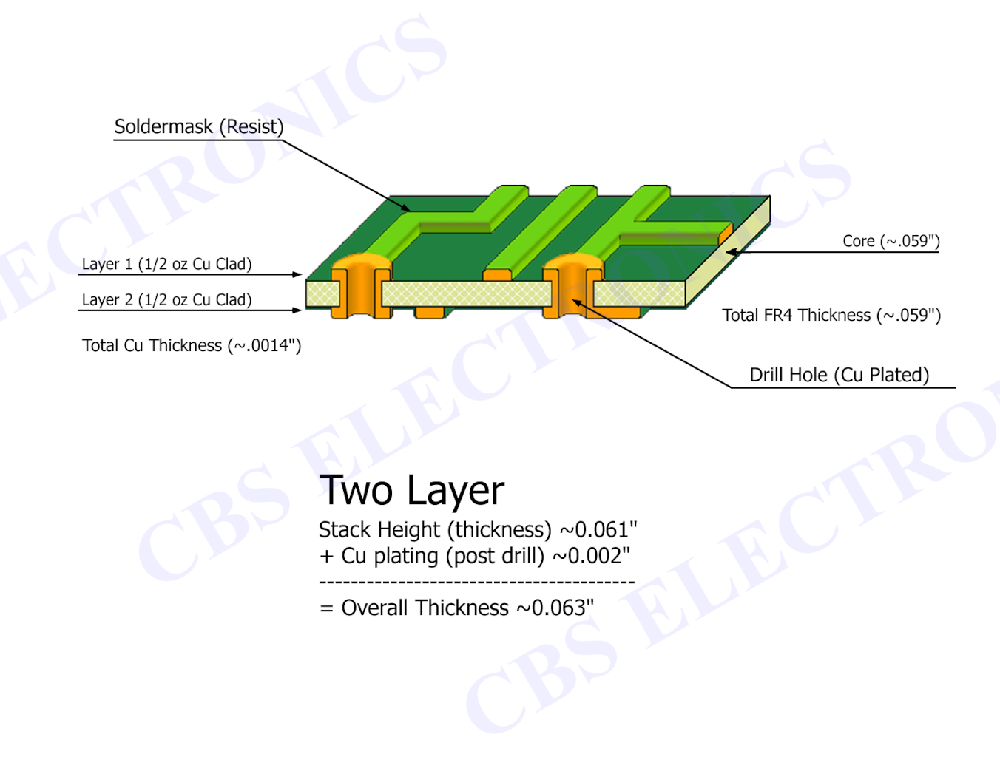
Klic Content:
Mechanical(Size shape, drill, Mounting holes)
Testing(vias, pins, etc)
By default, use 2 layers, 50 Ohm for SE and 85 Ohm for diff
Manufacture(min geometries and spacing)
Gerber or ODB++
Electrical(Stack up geometries, power)
Libraries(components footprints)
Schematic

Slide 24
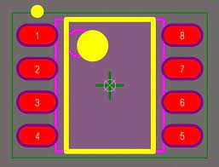
Klic Content:
Mechanical(Size shape, drill, Mounting holes)
Testing(vias, pins, etc)
Manufacture(min geometries and spacing)
Gerber or ODB++
Check or create all symbols' shapes and footprint.
Electrical(Stack up geometries, power)
Libraries(components footprints)
Schematic

Slide 25
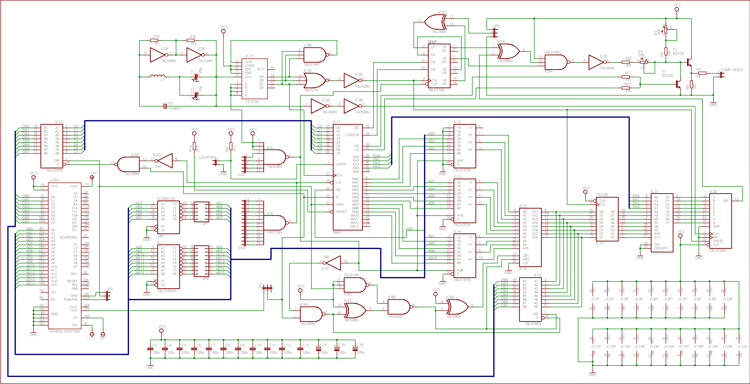
Klic Content:
Mechanical(Size shape, drill, Mounting holes)
Testing(vias, pins, etc)
Manufacture(min geometries and spacing)
Gerber or ODB++
Electrical(Stack up geometries, power)
Electronic design.
.
Libraries(components footprints)
Schematic

Slide 26
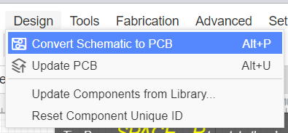
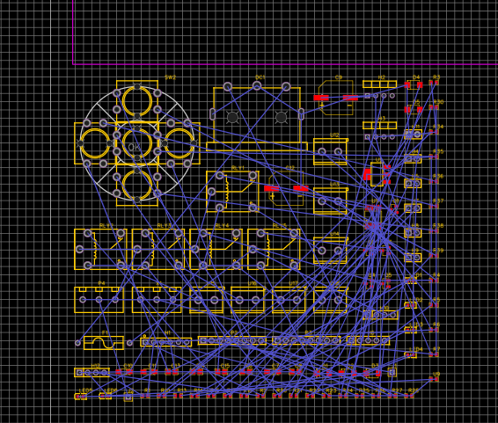
Starting the PCB
To make the placement, on any squematic page, goto Design->Convert Schematic to PBC.
it will place all footprints on the PCB canvas.
All blue lines are called “rats” they shows the missing connections, once the connection is completed, the rats will disappear automatically.

Slide 27
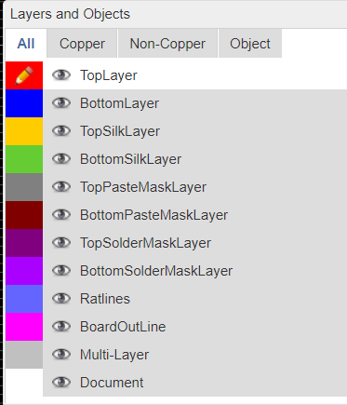
Main layers
Top/Bottom layer:
Are cupper layers, use them to make the routing
Top/Bottom Silk layer:
Used for notes, refdes, names, and text in general.
BoardOutLine:
It is the board edge.
Ratlines:
Are the dynamic lines that shows the connections missing.
Note:
The pencil shows the active layer. You can change it clicking on another layer.
The eye shaws the visible layer, you can show or hide clicking over them.

Slide 28
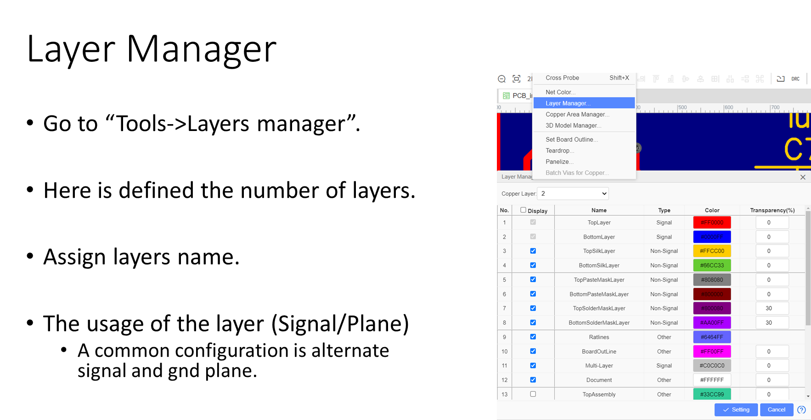

Slide 29
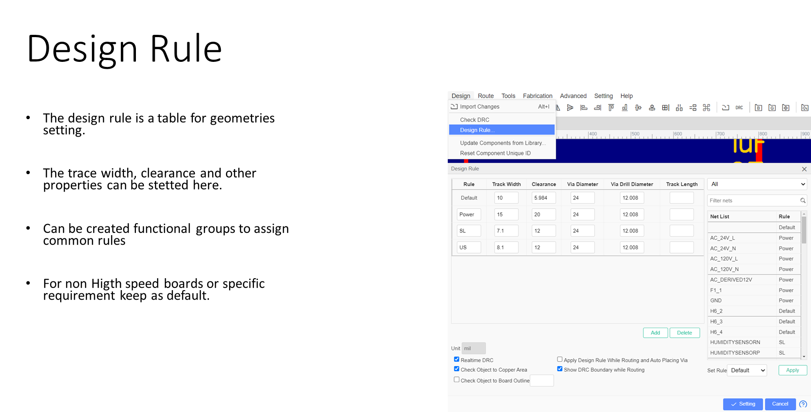

Slide 30
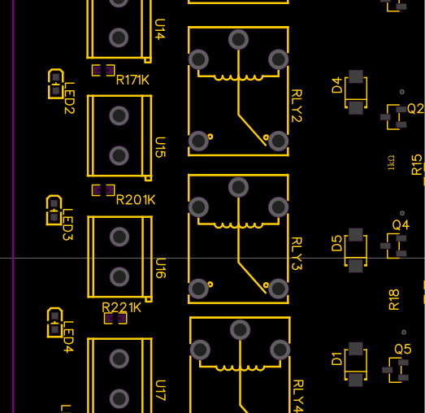
Placement
The first step is to place all components, try to make functionality groups.
Place the critical components first.
Take a way sensitive components of noisy components.
If it is possible replicate groups.
Make the placement compact to save space and money.

Slide 31
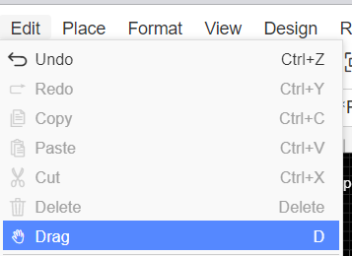
Move components
To move components, go to Edit->drag.
Click over the component.
Click to release
Right click to end command

Slide 32
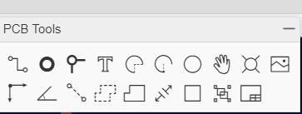
PCB Tools
These tools are to add traces or shape.
Track(w). Use it to make line connections.
Pad (p). It represent a pin connection.
Via (v). It is used to connect one layer with another

Slide 33
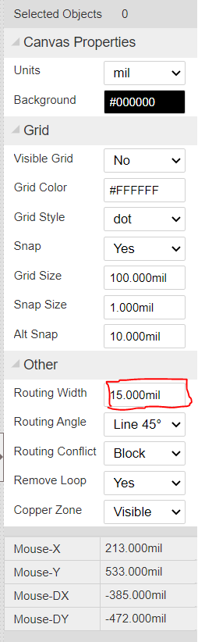
Connect components
Select the Top/BottomLayer.
Select the Track tool.
Set the width ( 1 mil = 0.0254 mm = 0.001 in)
Click over pin/via to start/end/turn traces
Right click to end command.
Any trace must have a GND on the adjacent/opposite layer.
The GND signals can be connected to a GND plane on adjacent layer using vias.

Slide 34
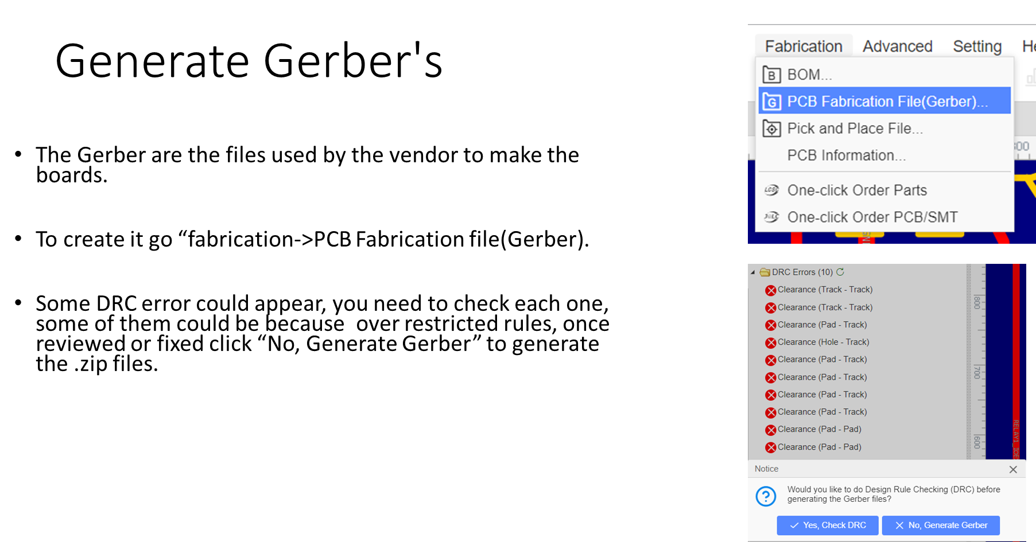

Slide 35
Klic Content: TO Process
Topic | Expectation | Comments
Sign OFF for TO Process | Understand Sign Off Process. | Understand the importance and implications of Reviews, Pedigree and Change list.
Tape Out (Board To be Manufactured)
The GERBERS to Fabrication are Generated
The FAB house need approve
The Project required sign off from All Stake holders.
At this point changes are only to Fix Problems

Slide 36
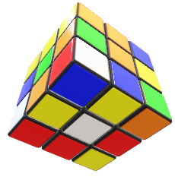
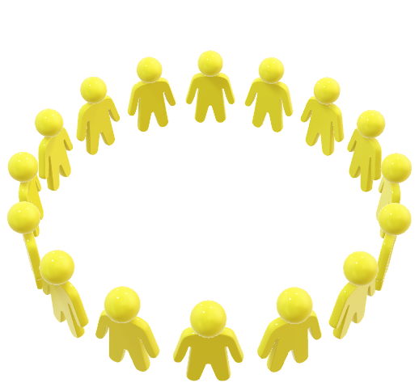
Take time to review that all project objectives are being met.
Review the Design
If this part is underestimated the results Can Be:
Additional Reworks or the Scrap of the project

Slide 37
If you detect something is Wrong:
Change list
Take a detail note in the Change list document.
Item #.
Revision.
Requestor.
Comments.
What is Affected SCH, Layout, BOM, CODE…
Tracking of the Item:
Status

Slide 38
If you do something Wrong:
Rework document
You must do detail note with the changes. (pedigree)
in the document clarify the Instructions and additional information such as
Short title like: Rotate the Connector for Sensors.
The Boards Affected : If your designs are reference for others.
The Purpose or Reason to do the rework: Impact if this rework is not applied.
Prerequisites: what will you need to do the Rework( Components, Tools etc…
Detailed step by step Instructions with : Image, Photo, Diagram, Sch all that you consider to be Clear.

Slide 39
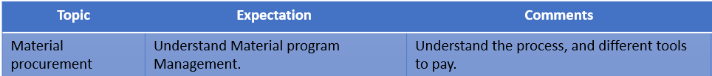
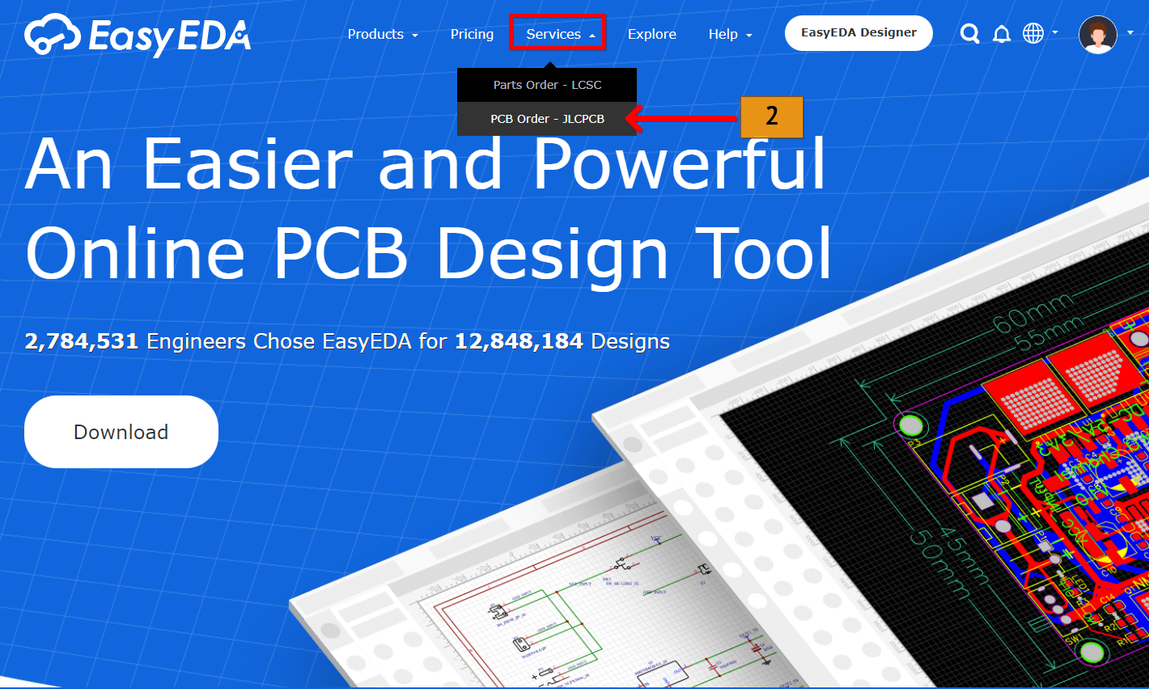
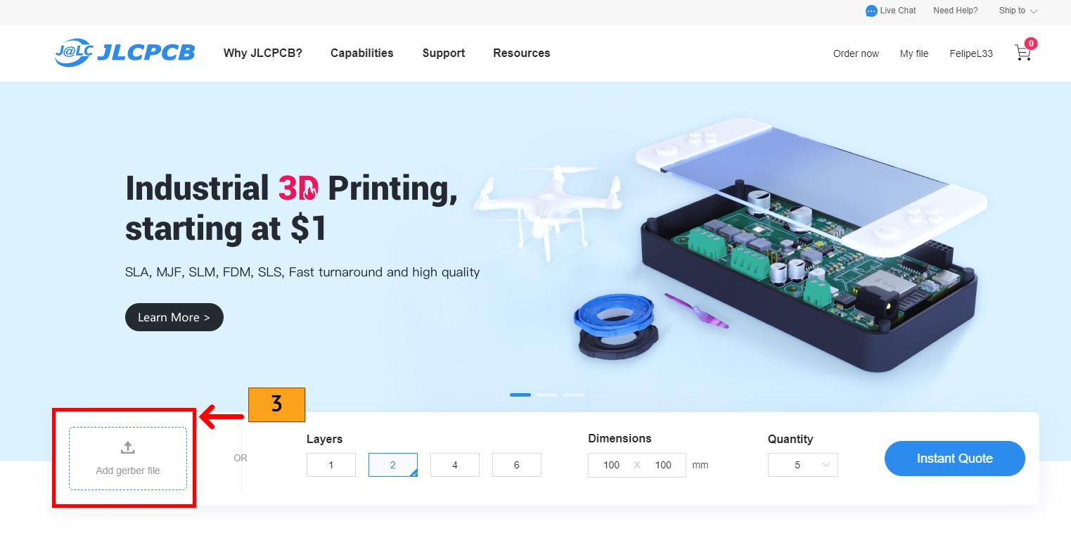
Log in https://easyeda.com/ and sign in
Chose Services and then PCB order – JLCPCB
Select “Add Gerber file” to upload your gerber

Slide 40
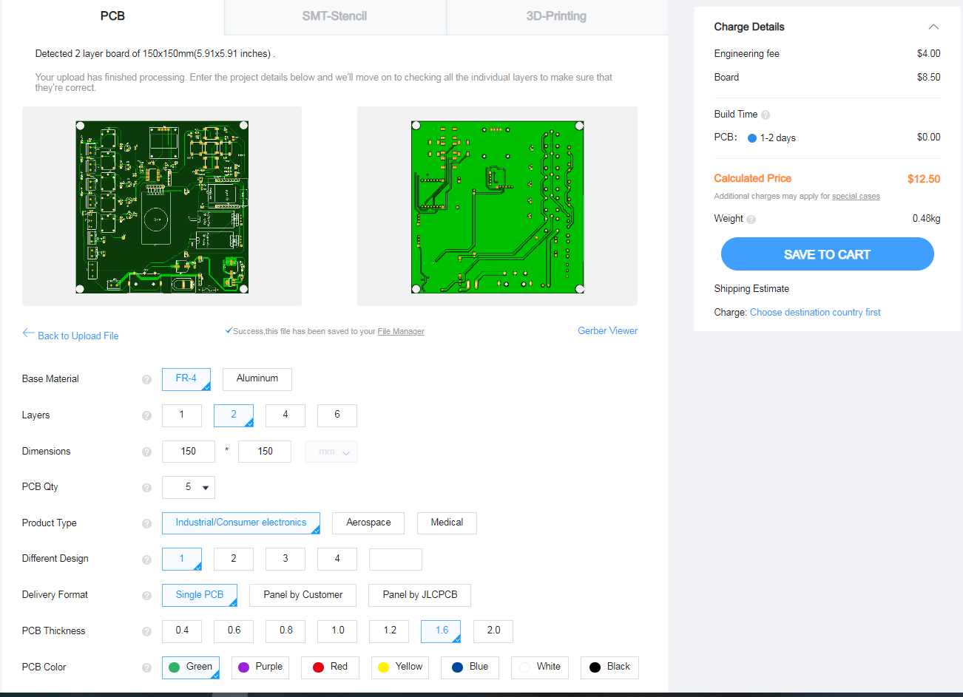
Klic Content: How to buy a PCB and additional components.
4 - After upload, your Gerber the tool is going to automatically detects layers and dimensions

Slide 41
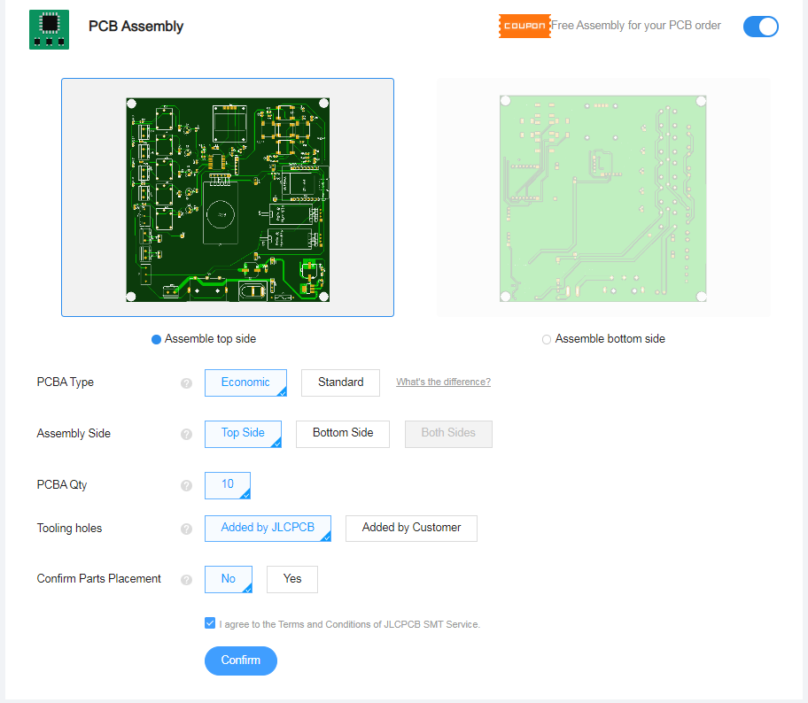
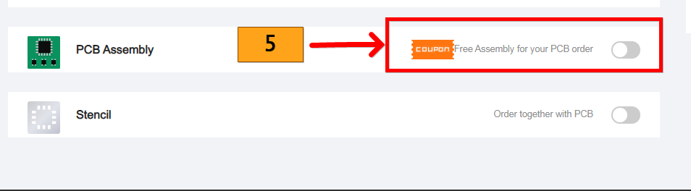
Klic Content: How to buy a PCB and additional components.
5 – PCB Assembly. Select Assembly for your PCB order if you want to also add the components placements in your PCB. Note. It could include assembly for Free

Slide 42


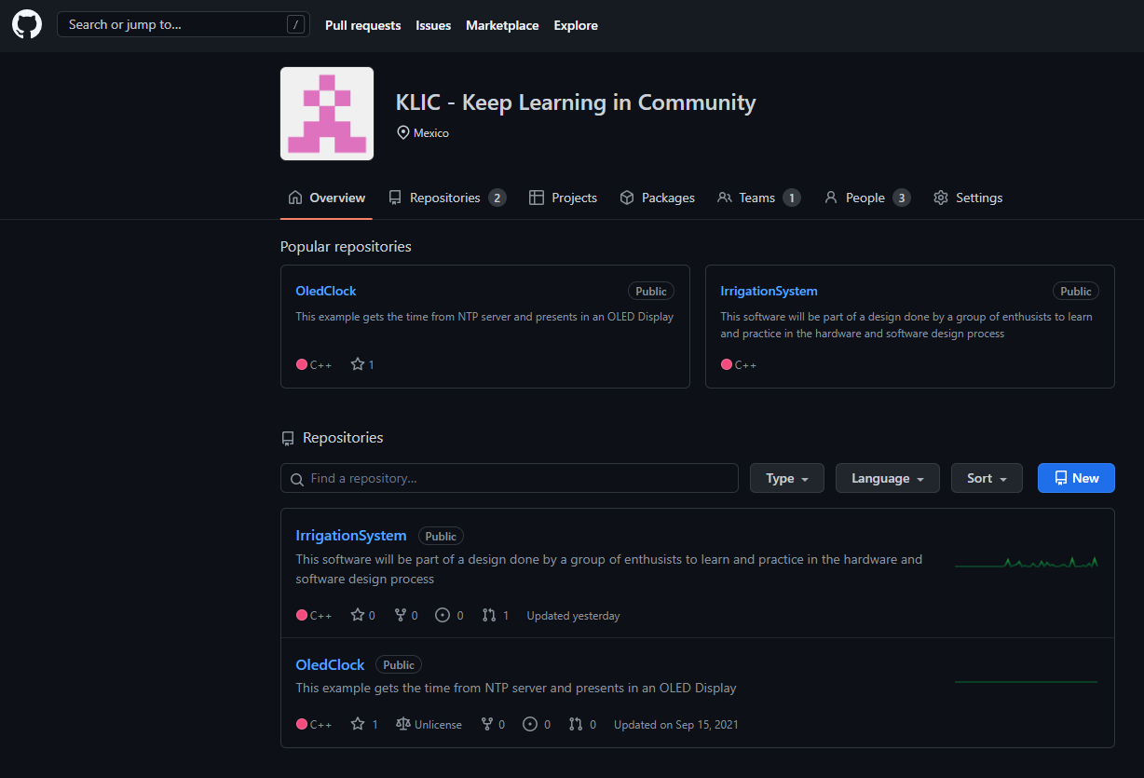
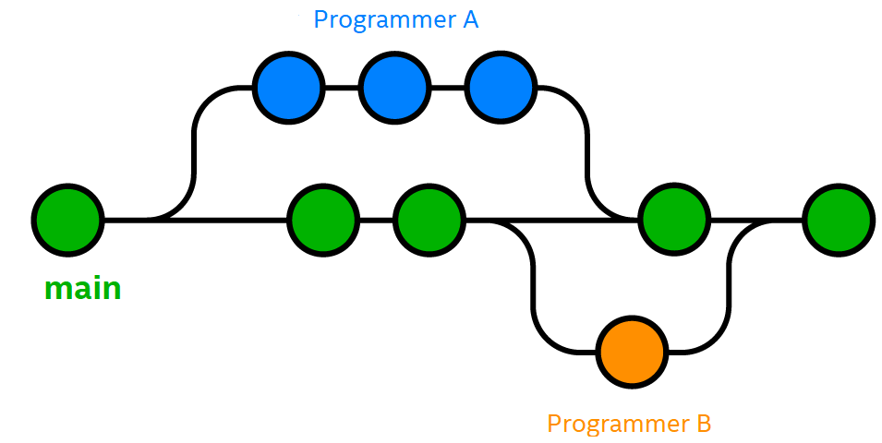
Topic | Expectation | Comments
GitHub -Software Tools | The use of GitHub to handle a software project. | Understand GitHub Use how we are using it in our project.
Git
Source Code management
- Version control system
- Track changes
- Allow code review before commit
GitHub
It is a hosting platform, but there are more
- GitLab, Bitbucket, Beanstalk, …

Slide 43
Klic Content: Git and GitHub
Create an account
https://github.com
Create your Token
Create a repo
https://docs.github.com/en/get-started/quickstart/create-a-repo
Clone your repo
Pre-requisites: have git installed
Configure your git
git config --global user.name "Name Lastname"
git config --global user.email "your@email"
git clone <repo address>
Create a development branch
git checkout –b mybranch
Create or modify your files
Add your changes (stage)
git add . (this means all)
Commit your changes (local repo)
git commit –s –m "Commens of the changes done"
Create a pull request (for someone else to review)
git push –u origin mybranch
Approve and merge
In the web page
For more Git information https://education.github.com/git-cheat-sheet-education.pdf

Slide 44
Topic | Expectation | Comments
Visual Studio Code / PlatformIO. | Explain how we are using Visual Studio to code our Micro Controller Code. | Understand different application to use depending in our needs and preferences.
Visual Studio Code &
PlatformIO

Slide 45
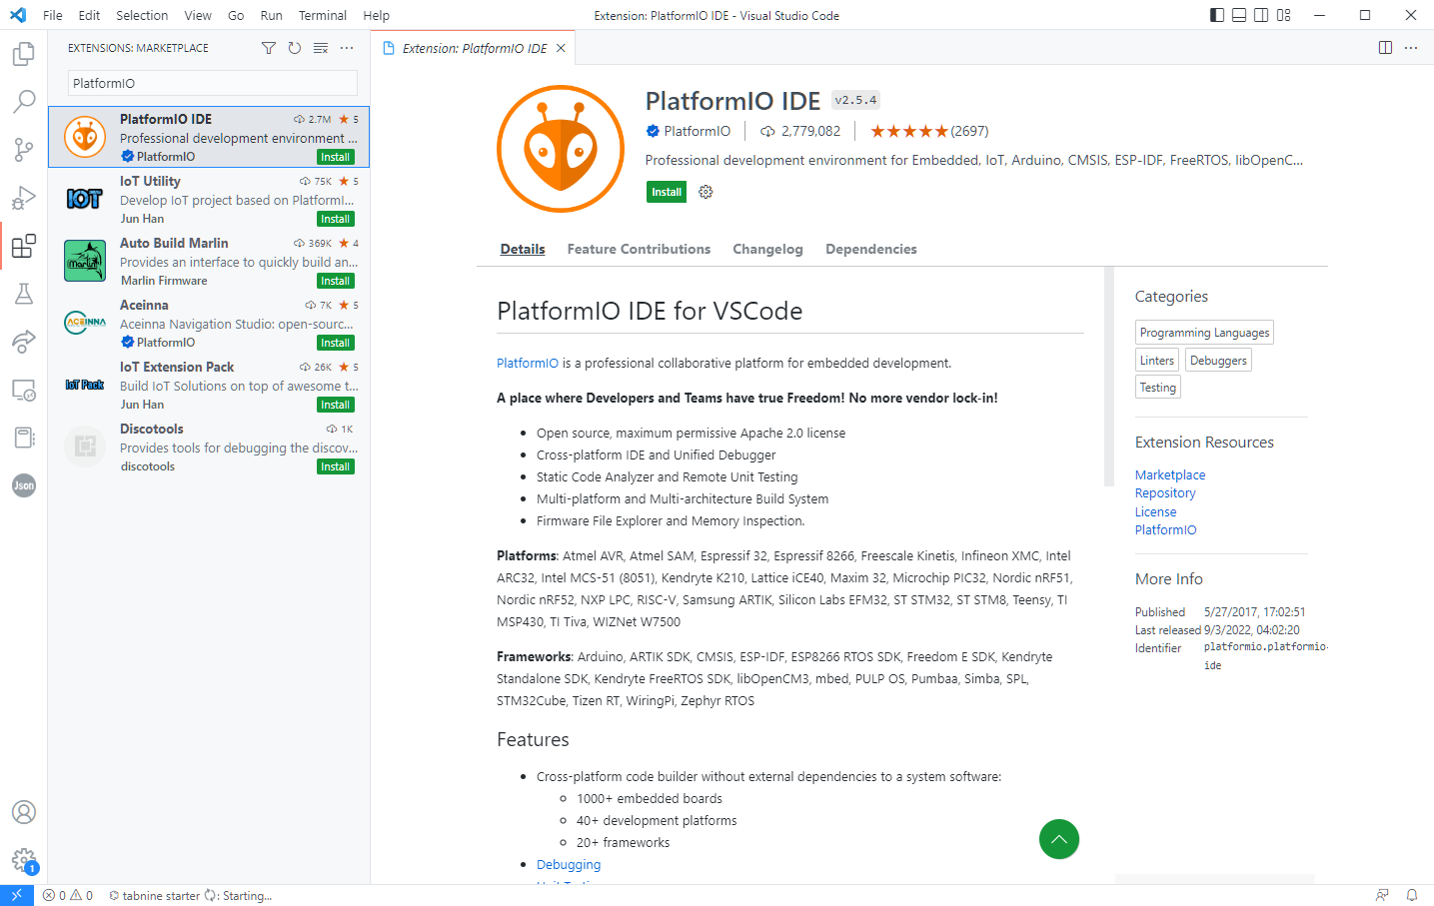
Visual Studio Code and how to install PlatformIO
2
3
1

Slide 47
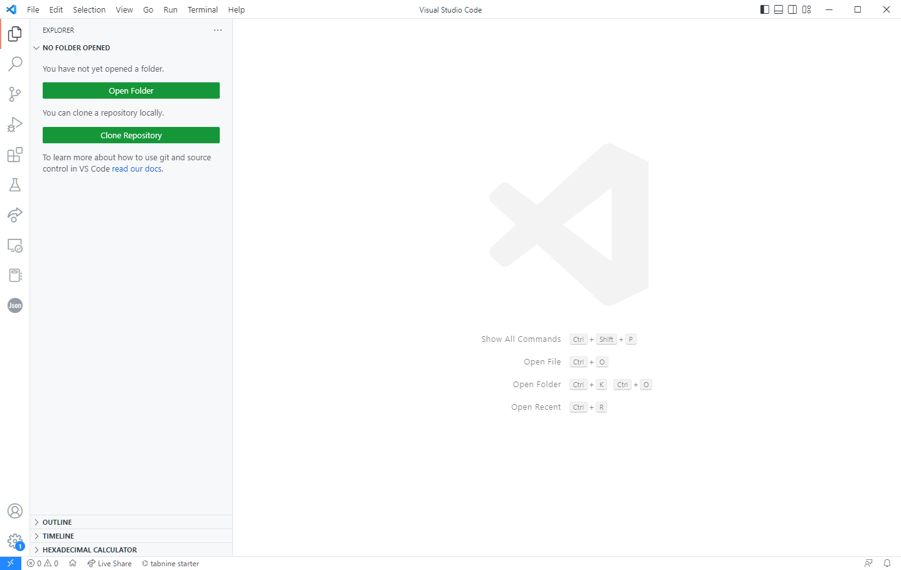
How to create a new project. (1/5)
Open PlatformIO Home

Slide 48
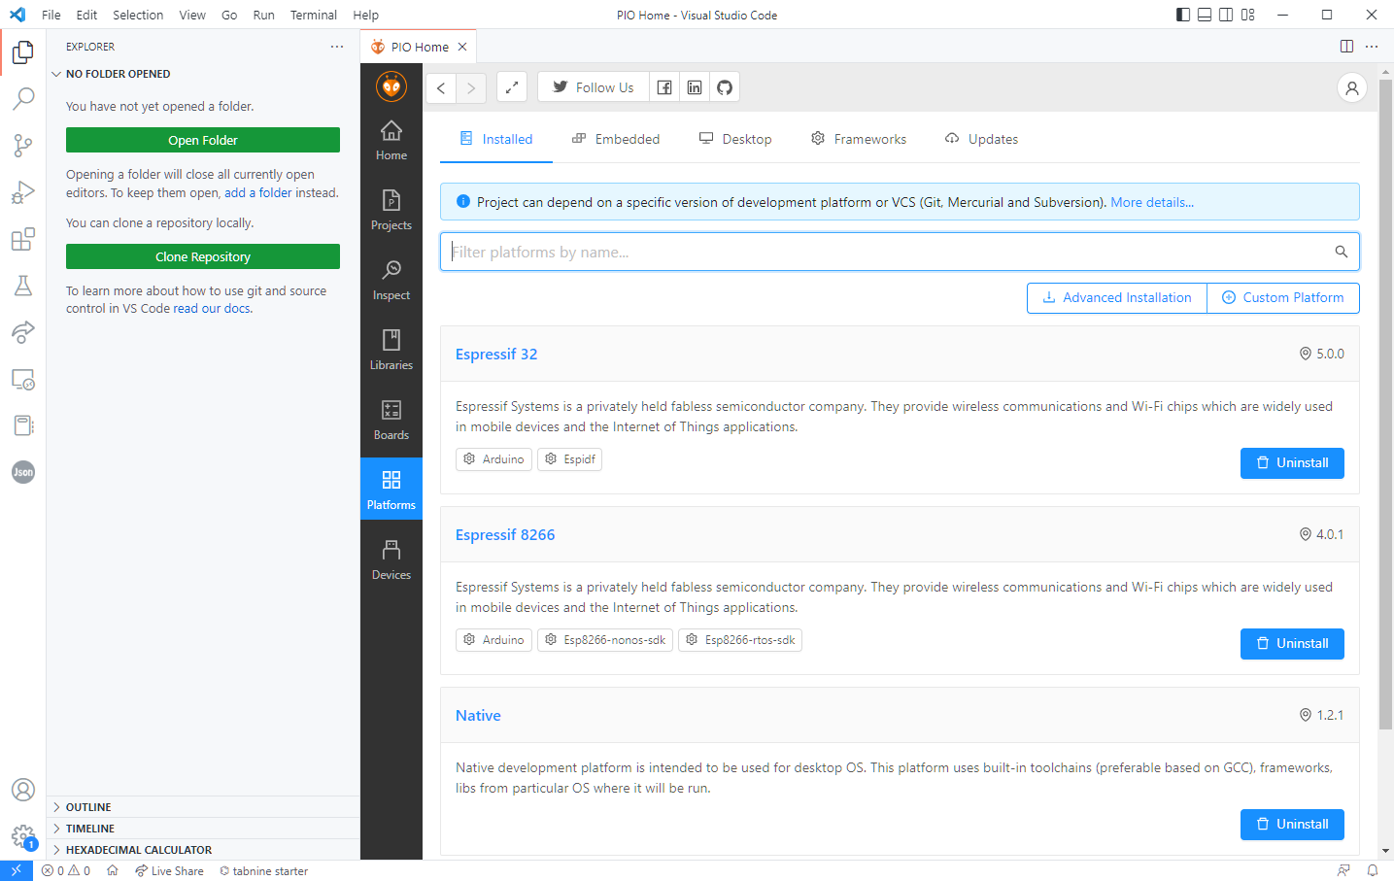
How to create a new project. (2/5)
Check Platforms installed.
If not, search it on the Embedded menu (*) And install the platform that you need.
*

Slide 49
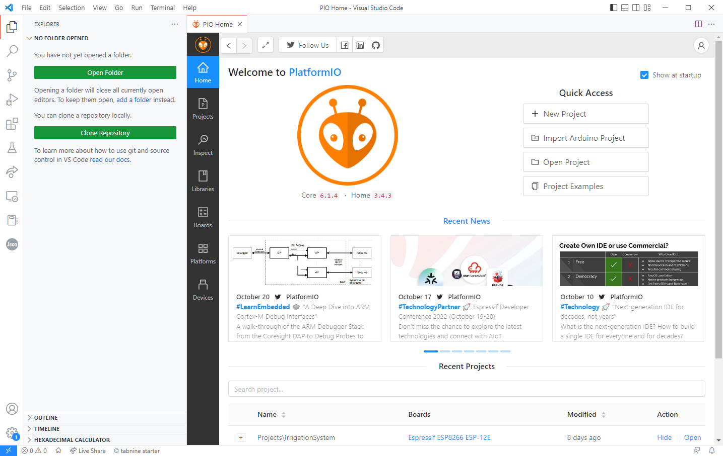
How to create a new project. (3/5)
New Project

Slide 50

Select board (4/5)

Slide 51

How to create a new project. (5/5)

Slide 52
How to create a new project. (5/5)

Slide 53

Structure of our new project.
Source files folder
Project configuration
Source file (main) Or in arduino this will be the .ino file.
PlatformIO Toolbar

Slide 54

Build your project.
Build log Here shows compilation errors or success build.
Build Icon

Slide 55
Flash to the device.
Flash log Here shows upload status and errors
Flash Icon

Slide 56
Open monitor serial
Monitor Serial Output
Monitor serial Button

Slide 57

++ Plus to practice coding skills.
Topic | Expectation | Comments
Online Compilers Cpp.sh | Understand different compilers options in the Web. | The intention is that we create one quick program and display results.
https://cpp.sh/
Compiler WEB Page.
It allow us to validate C/C++ code
If it compiles or not identifying issues.

Slide 58


Klic Content:
Topic | Expectation | Comments
Mechanical Design Tool FreeCAD | Understand different options | Share our current progress.
Windows
Multimedia
Graphic & Design
FreeCAD
Download
Download FreeCAD for PC
Free
In English
V 0.20.0
3.5
(264)
Security Status
FreeCAD free download
Free Downloadfor PC

Slide 59

Klic Content:
Topic | Expectation | Comments
Mechanical Design Tool FreeCAD | Understand different options | Share our current progress.

Slide 60

Quality & Learning
WW43’22
KLIC Team.

